Slide 1

Database Management System (DBMS)
(Course code: 21CS2110RA)
CO#1 ,Session#1:
Session Topic: Database Fundamentals

Slide 2
Session Objective
Students should be able to understand
  Basics of Database
  Basics of DBMS (Database Management System)
  Characteristics of DBMS
  Advantages & Disadvantages of DBMS

Slide 3
Key Concepts
Basic Terminology (Data, Information)
History of Database systems
Approaches to store data
File based Approach
Problems with traditional Approach
Database Approach
Operations on database
Components of Database
Database Management System (DBMS)
Database Characteristics
Differences between File and Database Approaches
Advantages & Disadvantages of DBMS

Slide 4
Basic Terminology (Data, Information)
The terms “data” and “information” are often used interchangeably, but they actually aren’t the same.
Data
(Raw facts and figures)
Processing
Information

Slide 5
What is Data ?
Data is defined as a collection of individual facts or statistics. (While “datum” is technically the singular form of “data,” it’s not commonly used in everyday language.)
Data can come in the form of
  text,
  observations,
  figures,
  images,
  numbers,
  graphs, or
  symbols.
For example, data might include individual prices, weights, addresses, ages, names, temperatures, dates, or distances,etc.

Slide 6
What is Data? Contd…
Data is a raw form of knowledge and, on its own, doesn’t carry any significance or purpose. In other words, you have to interpret data for it to have meaning. Data can be simple—and may even seem useless until it is analyzed, organized, and interpreted.
There are two main types of data:
Quantitative data is provided in numerical form, like the weight, volume, or cost of an item.
Qualitative data is descriptive, but non-numerical, like the name, gender, or eye color of a person.

Slide 7
What is Information?
Information is defined as knowledge gained through study, communication, research, or instruction.
Essentially, information is the result of analyzing and interpreting pieces of data. Whereas data is the individual figures, numbers, or graphs, information is the perception of those pieces of knowledge.
For example, a set of data could include temperature readings in a location over several years. Without any additional context, those temperatures have no meaning. However, when you analyze and organize that information, you could determine seasonal temperature patterns or even broader climate trends. Only when the data is organized and compiled in a useful way can it provide information that is beneficial to others.

Slide 8
The Key Differences Between Data vs Information
Data is a collection of facts, while information puts those facts into context.
While data is raw and unorganized, information is organized.
Data points are individual and sometimes unrelated. Information maps out that data to provide a big-picture view of how it all fits together.
Data, on its own, is meaningless. When it’s analyzed and interpreted, it becomes meaningful information.
Data does not depend on information; however, information depends on data.
Data typically comes in the form of graphs, numbers, figures, or statistics. Information is typically presented through words, language, thoughts, and ideas.
Data isn’t sufficient for decision-making, but you can make decisions based on information.

Slide 9
History of Database Systems
Databases are a foundational element of the modern world. We interact with them even without knowing it — any time we buy something online, or log in to a service, or access our bank accounts, and so on.
The concept of a database existed long before computers.
  In these times, data was stored in journals, in libraries, and in hundreds of filing cabinets.
  Everything was recorded via paper — and that meant it took up space, was hard to find, and difficult to back up.
And then computers became available, and with them, the opportunity for better data management.

Slide 10
History of Database Systems Contd…
The 1960s – beginnings
  Charles Bachman designed the first computerised database in the early 1960s. This first database was known as the Integrated Data Store, or IDS.
  This was shortly followed by the Information Management System, a database created by IBM.
Both databases were forerunners of the ‘navigational database’.
Navigational databases required users to navigate through the entire database to find the information they wanted.
There were two main models of this:
  hierarchical model (data is organised like a family tree)
  network model (a record to have more than one parent and child record)

Slide 11
Contd…
The 1970s – relational databases
A relational database is one that shows the relationship between different data records.
  searchable
  more space-efficient (reduced data storage costs)
  Ted Codd defined the relational data model
    Won the ACM Turing Award for this work
  IBM then released their relational database, named as, System R
    The first in the history of databases to use structured query language (SQL)

Slide 12
Contd…
The 1980s – growth and standardisation
  emergence of Object-oriented database management systems (OODBMS)
  view data as ‘objects’
  work with programming languages that supported the ‘object-oriented’ approach
The 1990s – the internet
  object oriented database systems grow more popular in the 90s.
  the creation of the World Wide Web
  demand for client-server database systems
  the creation of MySQL in 1995

Slide 13
Contd…
The 2000s – NoSQL
  In 1998, the term NoSQL (not only structured query language) was coined.
  It refers to databases that use query language other than SQL to store and retrieve data.
  NoSQL databases are useful for unstructured data, and they saw a growth in the 2000s.
  This is a notable development in the history of databases because NoSQL allowed for faster processing of larger, more varied datasets
The 2010s – distributed databases and cybersecurity
  The 2010s were a decade of increased data awareness, with the rise of big data and an increased emphasis on data protection.
  Big data was a major buzzword of the 2010 — and big data meant big databases to house it.

Slide 14
Approaches to store data
There are two approaches for storing data in computers:
File-based approach.
Database-approach.

Slide 15
File Based Approach
A filesystem is a method for storing and organizing computer files and the data they contain to make it easy to find and access them.
File systems may use a storage device such as a hard disk or CD ROM and involve maintaining the physical location of the files.
Programmers used programming languages such as COBOL, C++ to write applications that directly accessed files to perform data management services and provide information for users.

Slide 16
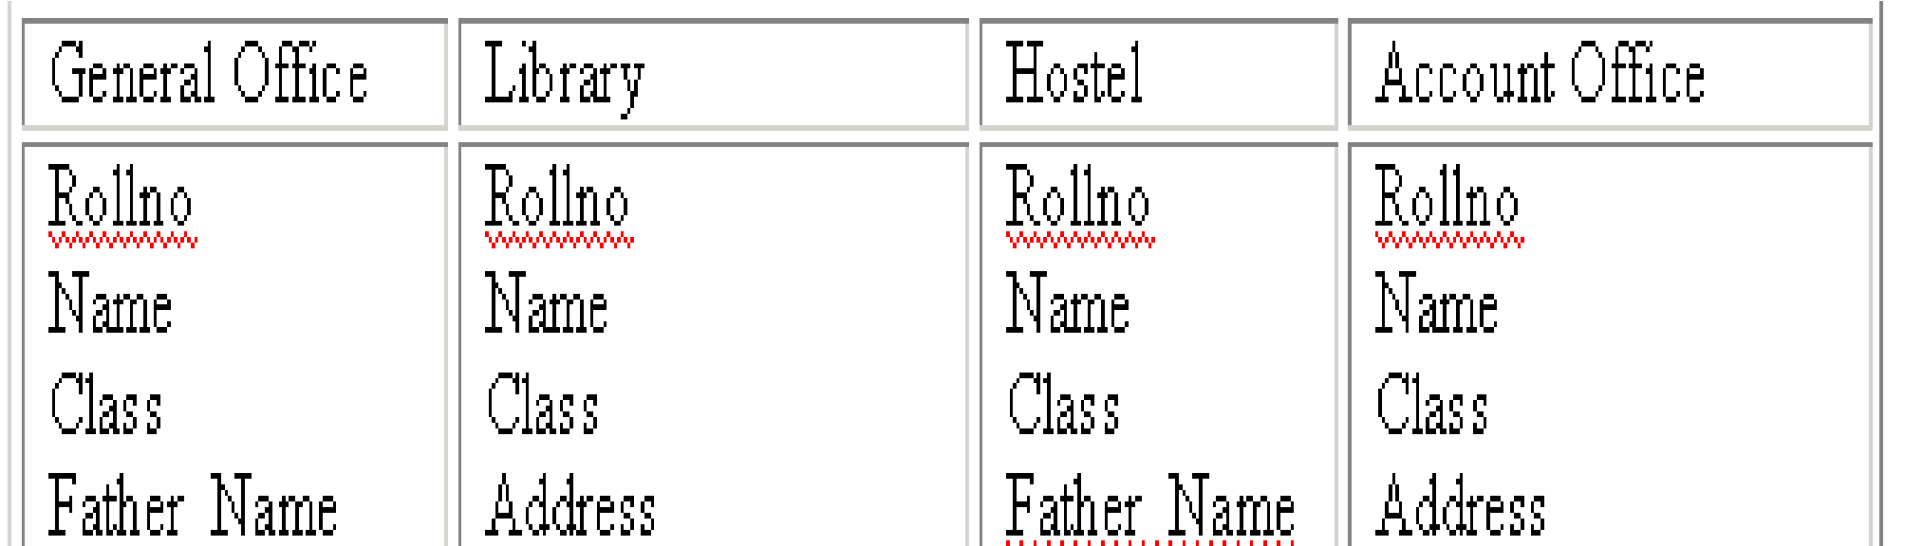
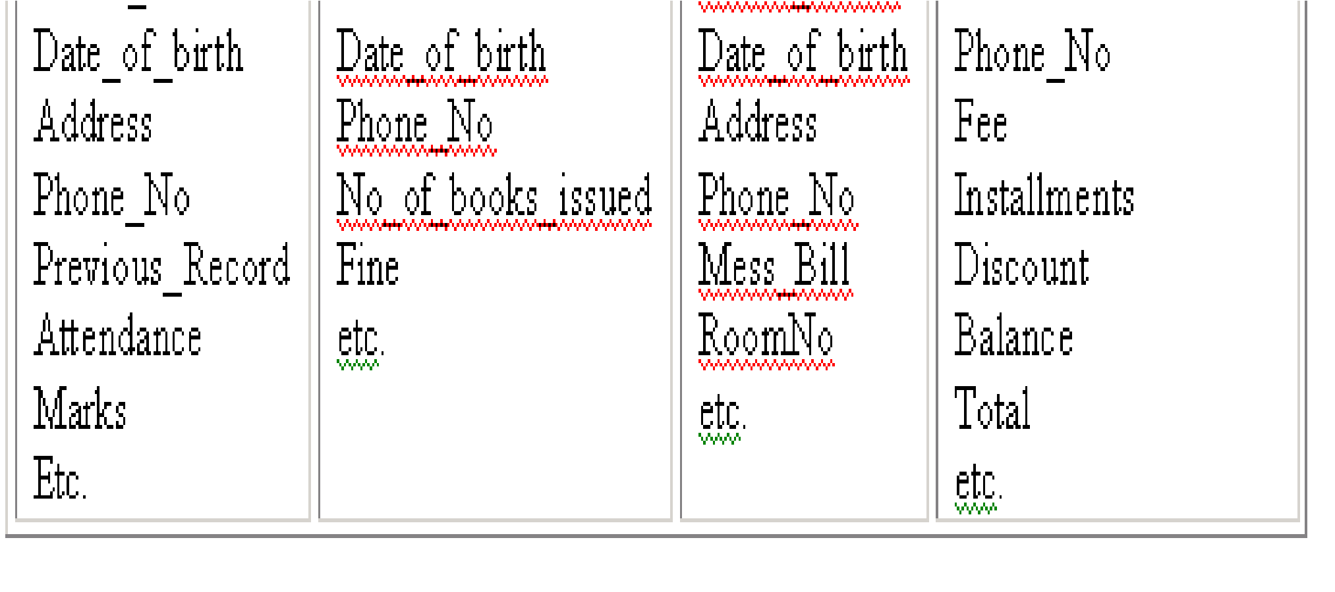
University Database in File Based System

Slide 17
Problems in traditional approach
Data Security
Data Redundancy
Data Isolation
Program / Data Dependence
Lack of Flexibility
Concurrent Access Anomalies

Slide 18
Database Approach
Database: “A collection of related data”
“A database system is referred as a collection of related data, which contains information about one particular organization”

Slide 19
Database Definitions
The database is a single, large repository of data, which can be used simultaneously by many departments and users.
The related information when placed is an organized form, then it is called a database.
It can also defined as
  Specifying data types, structures and constraints of the data to be stored.

Slide 20
Database contd…
A database system is a collection of related information stored, so that it is available to many users for different purposes.
A database system is essentially nothing more than a computerized record-keeping system. i.e. it is a computerized system whose overall purpose is to maintain information and make that information available on demand.
A database system is an electronic filing system, as it is a repository for a collection of computerized data files.

Slide 21
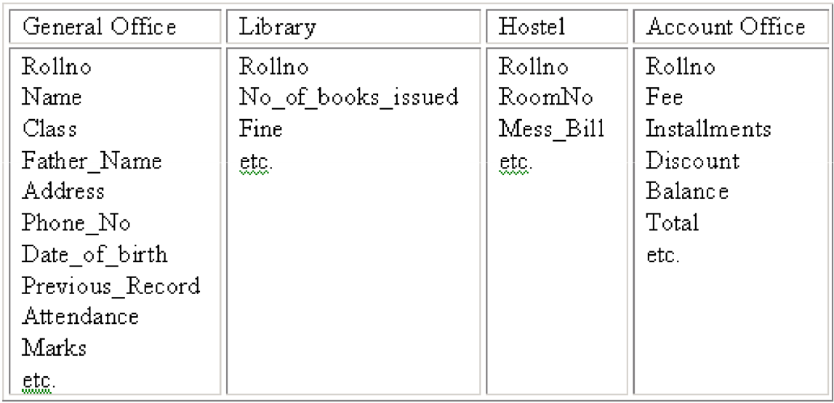
University Database in Database based System

Slide 22
Operations on Databases
To add new information
To view or retrieve the stored information
To modify or edit the existing
To remove or delete the unwanted information
Arranging the information in a desired order etc.

Slide 23
Components of Database
Database system involves four major components:
Data
Hardware
  Secondary storage (magnetic disks) together with the I/O devices, device controllers, I/O channels, to hold the stored data.
  Processor(s) and associated Main memory, to support the execution of the database system software.
Software
  The database manager (DB manager) or, more usually database management system (DBMS).
Users
  Casual end-users, Naïve users, DBA, System analyst, Sophisticated users, Database designers, Application Programmers.

Slide 24
Database Management System (DBMS)
DBMS is the major software component of database system to manage database, thus, it is called as database manager (DB manager).
All requests/queries from users for accessing to the database are handled by the DBMS.
DBMS interprets and processes user’s requests to retrieve information from a Database.
DBMS is a collection of interrelated files and a set of programs that allows several users to access and modify these files.
DBMS is a software package/ system to facilitate the creation and maintenance of a computerized database.

Slide 25
DBMS contd…
The DBMS acts as an intermediary/interface between the Database and the Users.
Queries
Database
Users
DBMS
OS
Programs
(COBOL/PL1/C/
Java…)
DBMS as an interface between physical Database and User’s requests

Slide 26
contd…
DBMS, A database management system is the software system that allows users to define, create and maintain a database and provides controlled access to the data.
A database management system (DBMS) is basically a collection of programs that enables users to store, modify, and extract information from a database as per the requirements.

Slide 27
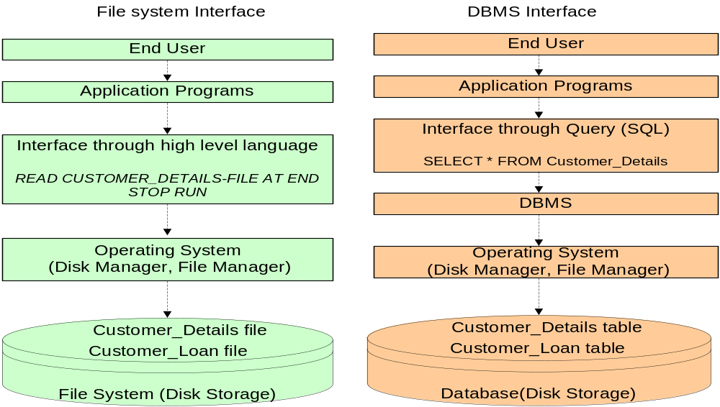
Difference Between File and DBMS Operations

Slide 28
Application Areas of DBMS
Banking
Airline
Universities
Credit card Transactions
Telecommunications
Finance
Sales
Manufacturing

Slide 29
Examples of DBMS
The top commercial DBMS:
  Oracle
  Microsoft SQL Server
  IBM DB2
  Microsoft Access, etc.
The top open source DBMS:
  MySQL
  PostgreSQL
  MongoDB
  Cassandra
  Redis
  SQL Lite, etc.

Slide 30
Which Database is Better : Commercial or Open Source Database ?
Both Commercial and Open Source database have their own Advantages and Disadvantages.
In most cases it makes sense to choose Open Source as compared to Commercial Database because :
  Open Source database is Cost effective.
  Better quality source code.
  More secure.
  More preferred.

Slide 31
Characteristics of the Database
Approach
Self-describing nature of a database system:
  A DBMS catalog stores the description of a particular database (e.g. data structures, types, and constraints)
  The description is called meta-data.
  This allows the DBMS software to work with different database applications.
Insulation between programs and data:
  Called program-data independence.
  Allows changing data structures and storage organization without having to change the DBMS access programs

Slide 32
Contin…
Data Abstraction:
  A data model is used to hide storage details and present the users with a conceptual view of the database.
  Programs refer to the data model constructs rather than data storage details
Support of multiple views of the data:
  Each user may see a different view of the database, which describes only the data of interest to that user

Slide 33
Contin…
Sharing of data and multi-user transaction processing:
  Allowing a set of concurrent users to retrieve from and to update the database.
  Concurrency control within the DBMS guarantees that each transaction is correctly executed or aborted
  Recovery subsystem ensures each completed transaction has its effect permanently recorded in the database
  OLTP (Online Transaction Processing) is a major part of database applications. This allows hundreds of concurrent transactions to execute per second

Slide 34
Advantages of DBMS
Integrity can be enforced: Integrity of data means that data in database is always accurate, such that incorrect information cannot be stored in database
Controlling Redundancy: Duplication of data is almost avoided but not completely.
Inconsistency can be avoided: When the same data is duplicated and changes are made at one site, which is not propagated to the other site, it gives rise to inconsistency and the two entries regarding the same data will not agree

Slide 35
Other Advantages
Data can be shared.
Data Independence.
Concurrent access.
Recovery from crashes.
Providing Backup and Recovery.
Restricting unauthorized access.
Solving enterprise requirement than individual requirement

Slide 36
Disadvantages of DBMS
Complexity
Higher impact of a failure.
Cost of DBMS.
Additional Hardware costs.

Slide 37
References
Database System Concepts, Sixth Edition, Abraham Silberschatz, Yale University Henry, F. Korth Lehigh University, S. Sudarshan Indian Institute of Technology, Bombay.
Fundamentals of Database Systems, 7th Edition, RamezElmasri, University of Texas at Arlington, Shamkant B. Navathe, University of Texas at Arlington.

